Slide 1
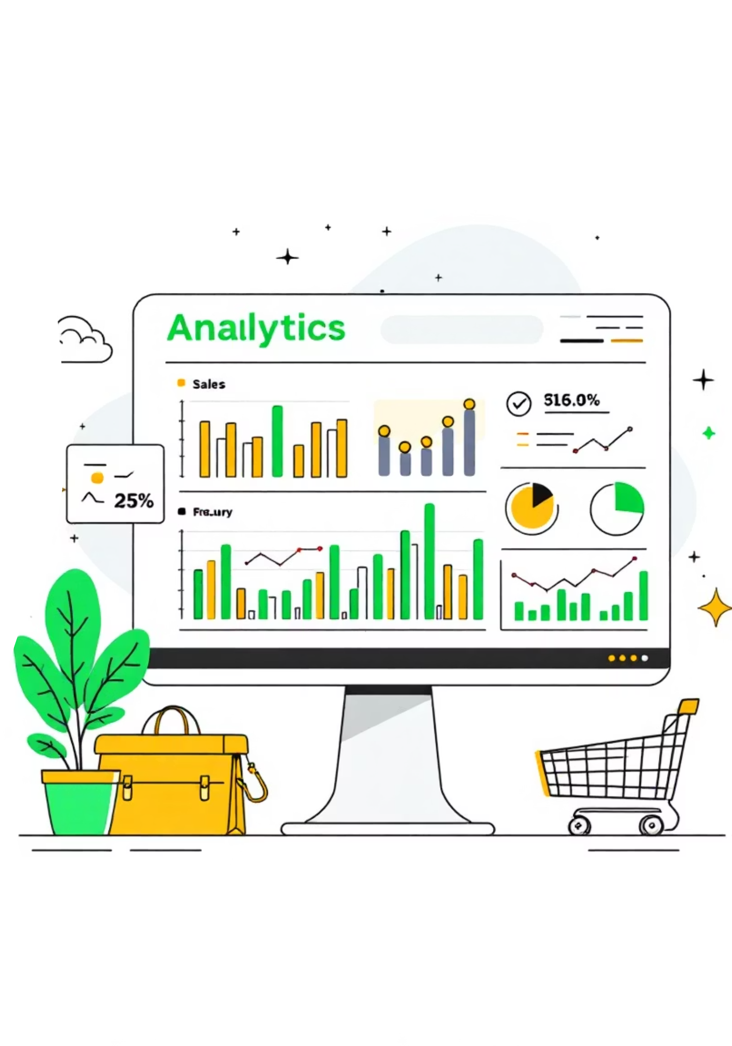
Customer Shopping Behavior Analysis
Uncovering insights from 3,900 purchases to drive strategic business decisions

Slide 2
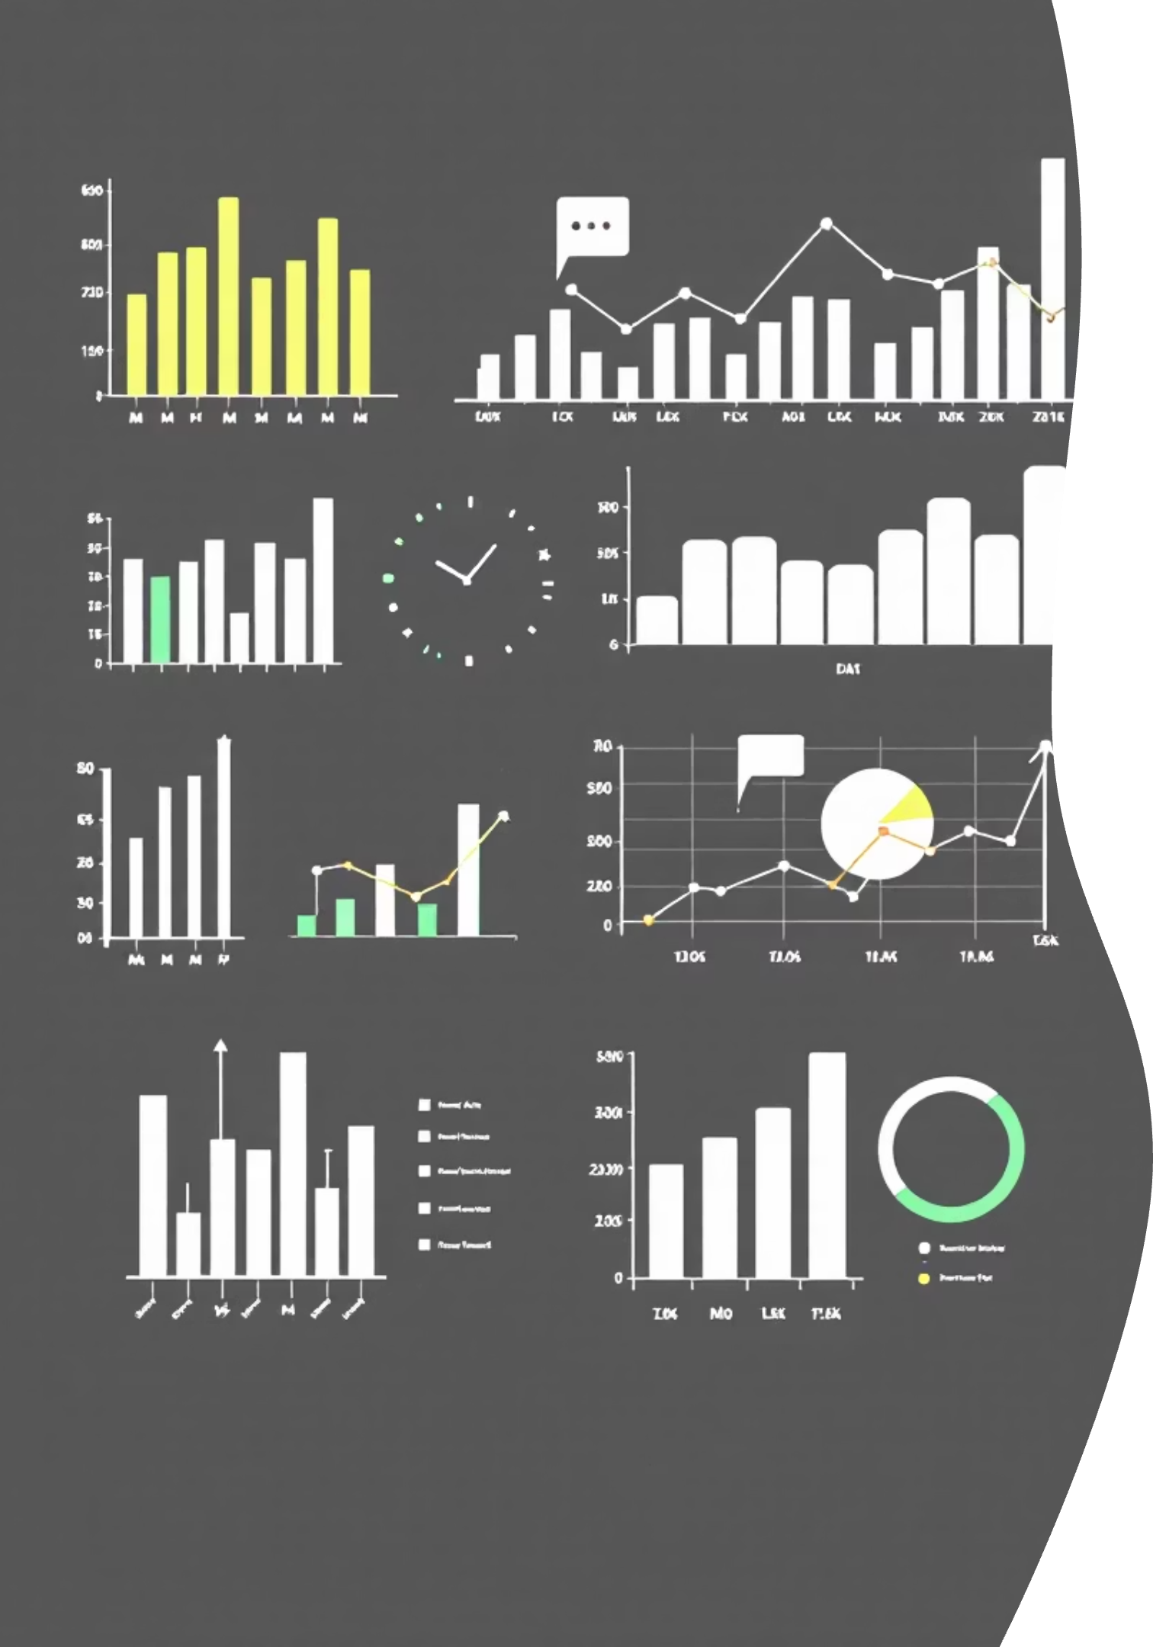
Dataset at a Glance
3,900
18
4
Total Purchases
Data Points
Categories
Transactions analyzed
Features per transaction
Product segments tracked
50
Locations
Geographic coverage

Slide 3
Data Preparation Journey
01
02
Data Loading & Exploration
Cleaning & Standardization
Imported dataset using pandas, analyzed structure with df.info() and summary statistics
Handled 37 missing review ratings, standardized columns to snake_case format
03
04
Feature Engineering
Database Integration
Created age_group bins and purchase_frequency_days for deeper insights
Connected to PostgreSQL for advanced SQL analysis and querying

Slide 4
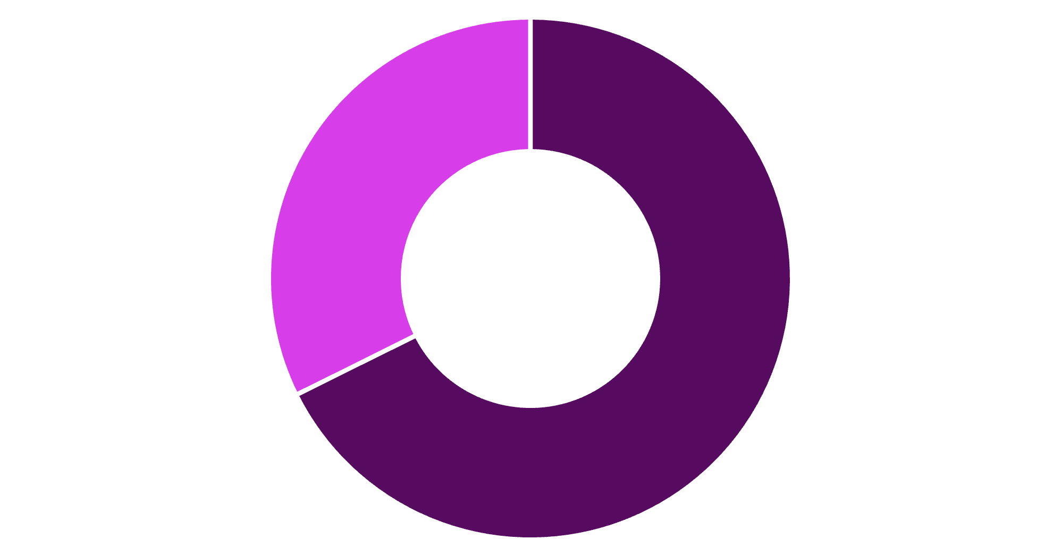
Revenue by Gender
Key Insight
Male customers generate 68% of total revenue, more than double female customer spending
Strategic opportunity for targeted marketing campaigns
Male
Female

Slide 5
Top Performing Products
1
2
3
Gloves
Sandals
Boots
Average rating: 3.86
Average rating: 3.84
Average rating: 3.82
4
5
Hat
Skirt
Average rating: 3.80
Average rating: 3.78

Slide 6



Customer Segmentation Breakdown
New
1
83 customers
Returning
2
701 customers
Loyal
3
3,116 customers
80% of customers are loyal – strong retention foundation with opportunity to convert returning buyers

Slide 7
Subscription vs. Non-Subscription Performance
Similar average spending patterns, but 73% of customers remain unsubscribed
Subscribers
1,053 customers
Major opportunity to grow subscription base and recurring revenue
Avg spend: $59.49
Total revenue: $62,645
Non-Subscribers
2,847 customers
Avg spend: $59.87
Total revenue: $170,436

Slide 8
Discount Strategy Analysis
50%
49.66%
49.07%
Hat
Sneakers
Coat
Highest discount rate
48.17%
47.37%
Sweater
Pants
839 high-spending customers used discounts but still purchased above average – smart shoppers seeking value

Slide 9
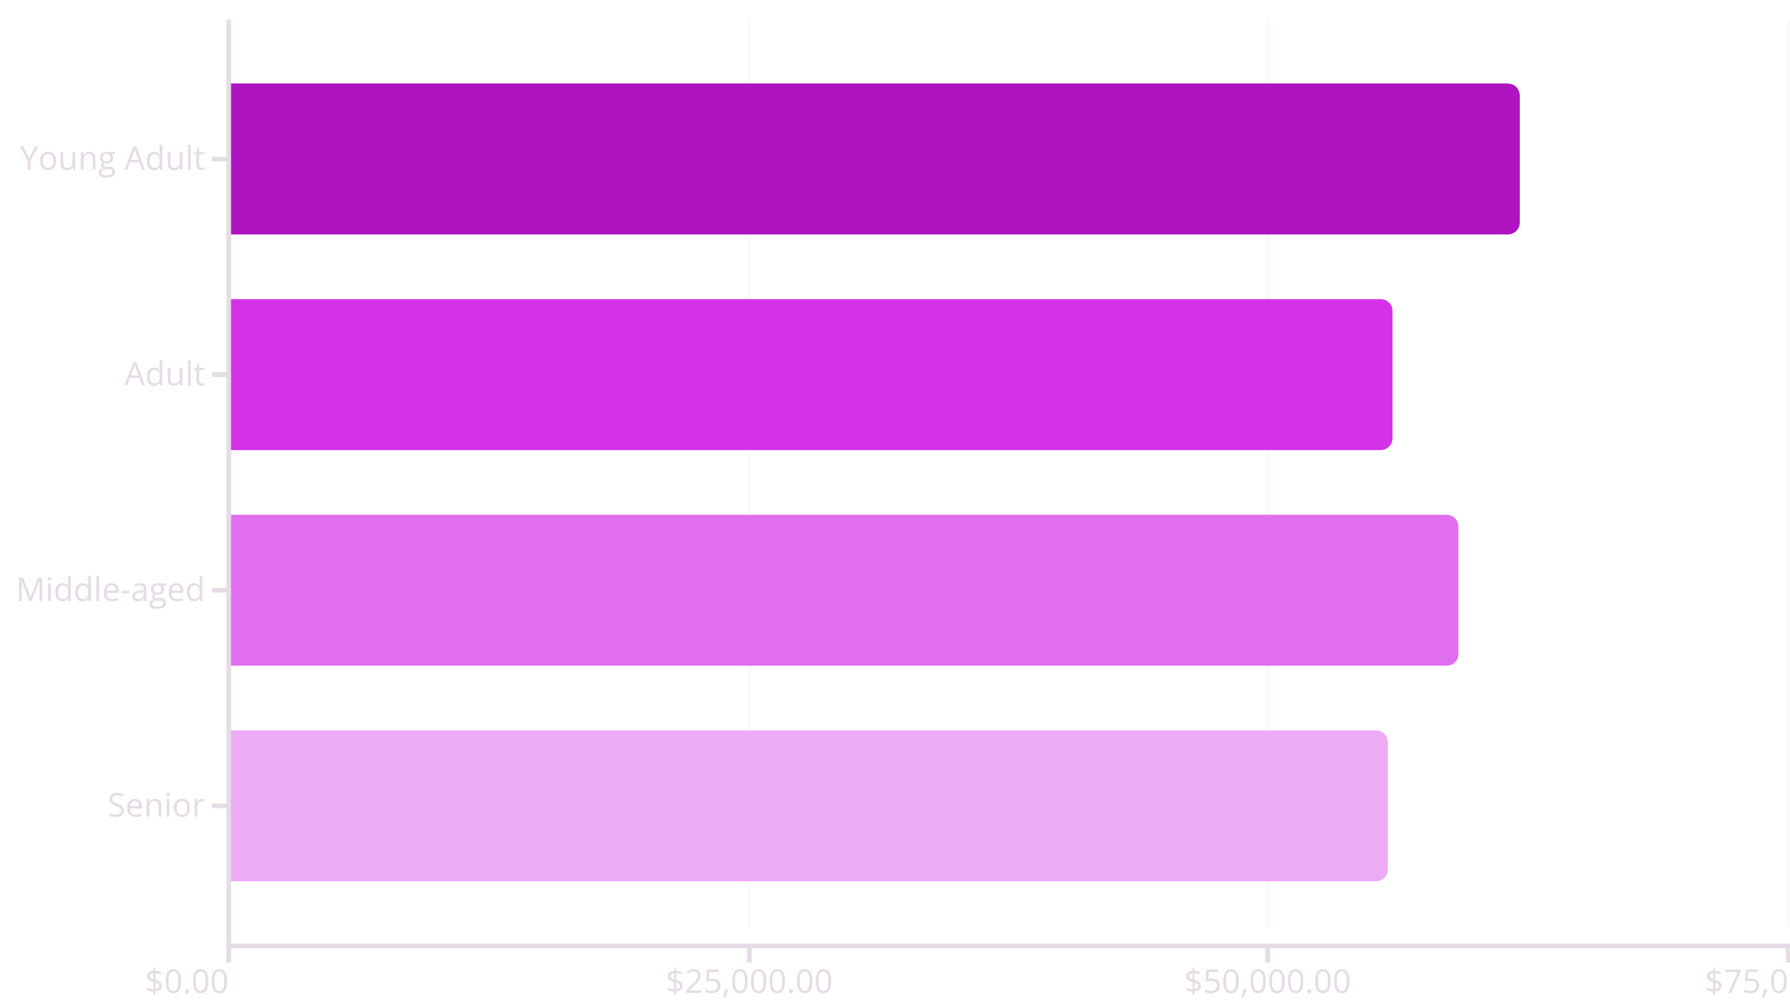
Revenue by Age Group
Young adults lead revenue generation, but all segments show balanced contribution – diversified customer base

Slide 10


Strategic Recommendations
Boost Subscriptions
Promote exclusive benefits to convert 73% non-subscribers
Loyalty Programs
Reward repeat buyers to strengthen 80% loyal base
Review Discounts
Balance sales boosts with margin control on high-discount items
Targeted Marketing
Focus on high-revenue segments and top-rated products

